Slide 1
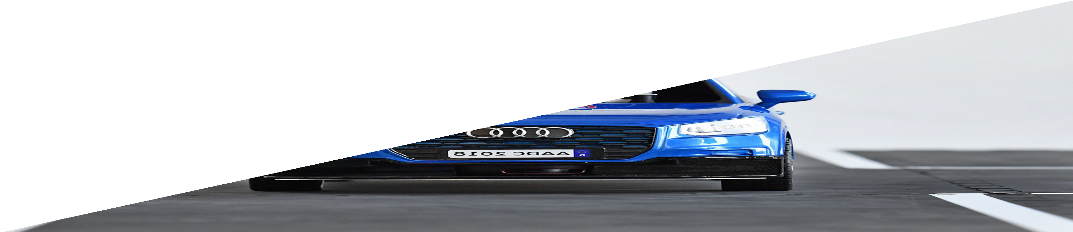
Connected and Autonomous Automotive Software Engineering
Praxis: Datenmanagement im Autonomen Fahren
B.Sc. Yiwei Wu
M.Sc. Abhishek Buragohain
Dr.-Ing. Meng Zhang

Slide 2
Praxis Project Overview
Praxis project involves two teams, each consisting of 3-4 members, tasked with designing and implementing a Python-based system in Robotics Operating system (ROS) , for recording and managing sensor data from a virtual vehicle in a simulation environment called CARLA .
Documentation Requirements:
Provide an understanding of systems architecture and components.
Utilize UML diagrams, including Class, Component, and sequence diagrams, to illustrate the system's structure and functionality.

Slide 3
Functional Requirements
These requirements deﬁne the essential functionalities of the system.
Data Recording
The vehicle sensor data shall be recorded while the Vehicle is driving in simulation as ROS2 bags.
Local Storage
The recorded sensor data shall be stored locally and temporally on shared folder with limited capacity 100MB.
Cloud Server Upload
The data shall be uploaded to the cloud folder for persistent storage.
Real-time Monitoring and Error Handling
Real-time monitoring should be implemented for storage and internet status.
Notify when:
Temporal storage is full.
Internet connection is off.
A procedures should be applied to ensure data storage or transfer is not affected by these issues.
If the network goes oﬄine during data transfer, promptly assess whether to redo the transfer or proceed, ensuring the integrity of the transferred ﬁle remains unaffected."

Slide 4
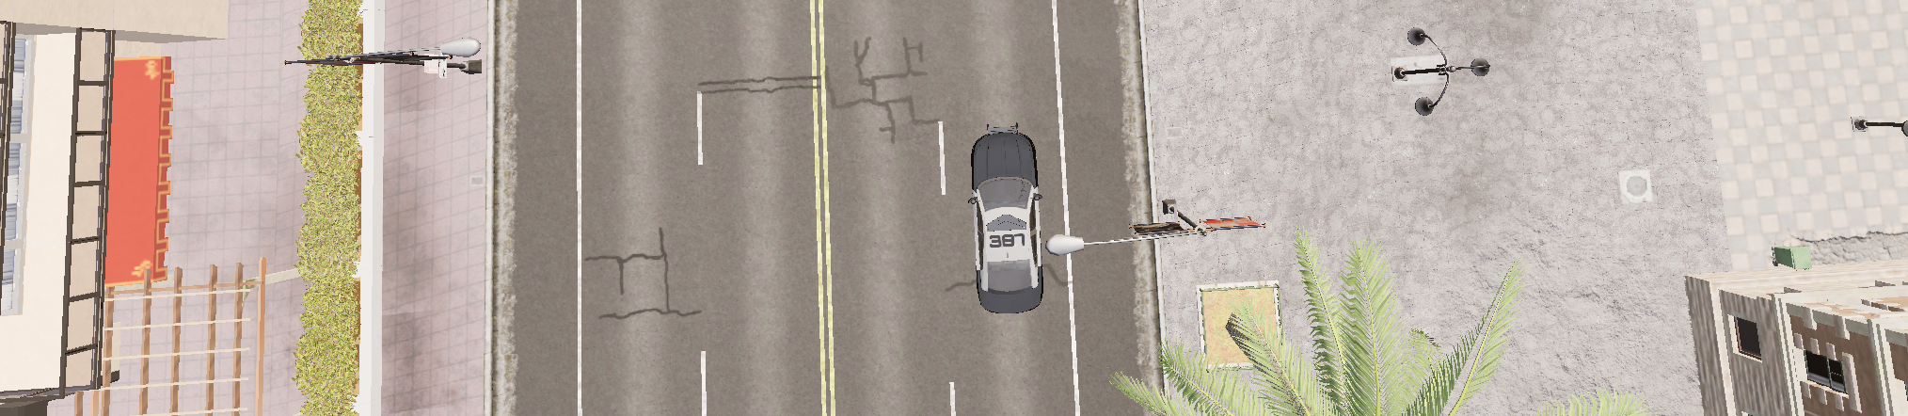
Functional Requirements
These requirements deﬁne the essential functionalities of the system.
Synchronized data :The data should be correctly synchronized from all sensors based on timestamps.
Bonus Feature: Eﬃcient Lidar Data Handling:
The system should support the storage and upload of signiﬁcant Lidar data parts. Lidar data is recorded in a 360-degree range.
Data recording shall be implemented to record the LiDAR sensor data, when Lidar data are detected within a static region of interest (ROI).
ROI is assumed as a rectangular region around the virtual vehicle.(as seen below)
You shall record the LiDAR data when it is detected within detected within this region.
Region of Interest

Slide 5
Quality Requirements
These requirements ensure the system's reliability, eﬃciency, and maintainability.
Data Loss detection
The system should detect data loss as the variance between data stored on the cloud server and data recorded on the vehicle. Data Quality
The data should complete and valid: No broken ﬁles, complete as no missing sensor data
➢
Code Quality
You should write understandable and clean code : realistic variable names that convey their purpose, avoid overly complex coding; prioritize simplicity and readability, follow Object-Oriented Programming (OOP) concepts for a structured design, Include comments in functions to provide clear descriptions of their purpose and functionality.

Slide 6


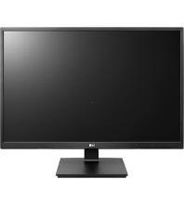



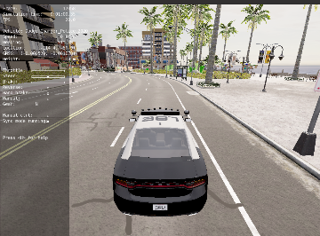
Randbedingungen im Labor
CLOUD DATA STORAGE
CARLA simulation
2-3 Students per PC
CARLA_ROS_BRIDGE
Data Repository (ohne Kapazitätslimit)
Data Persistence
ROS2 FRAMEWORK
Data Temporary Storage
SENSOR DATA FILTERING & RECORDING COMPONENTS
Shared Folder: max. 100MB

Slide 7
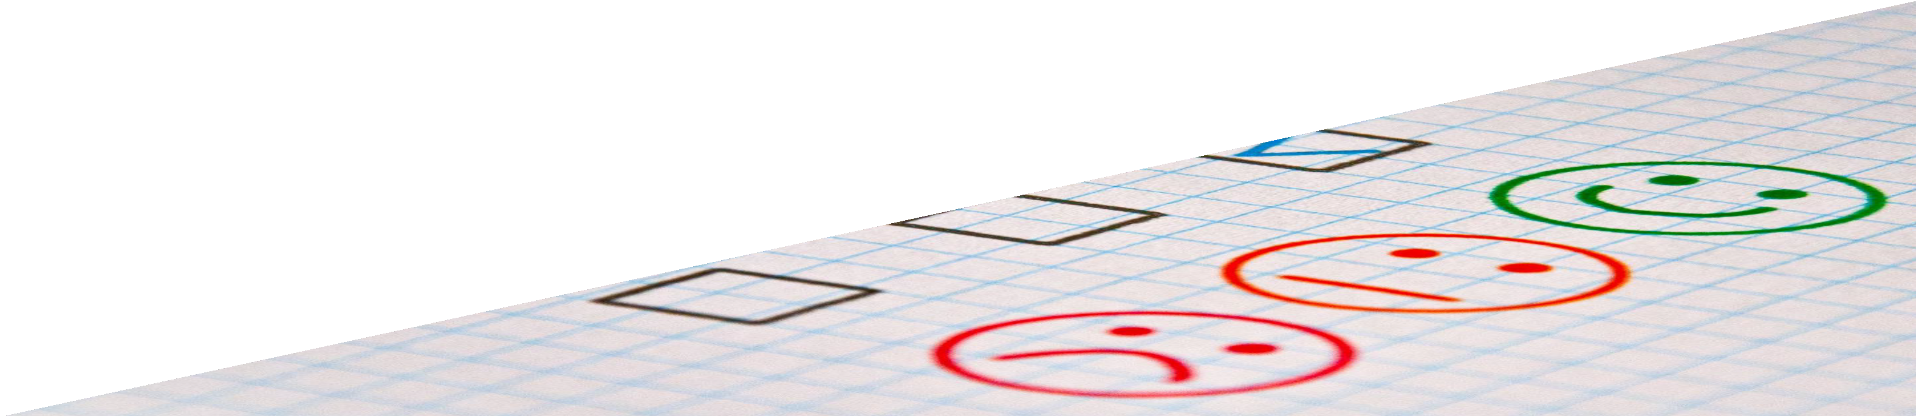
VIELEN DANK FÜR IHRE AUFMERKSAMKEIT

